Slide 1
Active learning

Slide 2
1. satellite image classification dataset
Introduction:
Today we embark on an intriguing journey into the realm of satellite image classification, where we explore the application of active learning strategies to enhance model performance. With the ever-increasing availability of satellite imagery, accurate classification holds immense value in various domains such as environmental monitoring, urban planning, and disaster response.
Objective:
Our primary objective is to investigate the efficacy of active learning strategies in improving the accuracy and efficiency of satellite image classification tasks. Through this exploration, we aim to shed light on the potential benefits of active learning and its relevance in the context of satellite imagery analysis.

Slide 3
Dataset Overview:
Before delving into the strategies, let's familiarize ourselves with the dataset used in this study. We employ an image dataset containing satellite imagery, organized into different classes representing distinct geographical features or land cover types. This dataset serves as the foundation for our classification task.

Slide 4
satellite image classification data
Methodology:
1-Data Preprocessing: The satellite image dataset is preprocessed using standard transformations such as resizing and normalization to ensure uniformity and compatibility with the model architecture.
2-Model Selection: For our experiments, we adopt the ResNet-50 architecture, a deep convolutional neural network renowned for its effectiveness in image classification tasks.
3-Supervised Learning Baseline: Initially, we train ResNet-50 model using traditional supervised learning techniques, where the entire labeled dataset is utilized for training.

Slide 5
satellite image classification data
4-Active Learning Strategies:
Random Sampling: We start our exploration by randomly selecting data points from the unlabeled pool for labeling, providing a baseline for comparison.
Entropy Sampling: This strategy identifies data points where the model exhibits the highest uncertainty in predictions, based on entropy calculations.
Uncertainty Sampling: Here, data points are selected for labeling based on the model's uncertainty in predictions, particularly focusing on instances with low prediction confidence.
Disagreement Sampling: Leveraging the concept of model disagreement, this strategy selects instances where multiple models within an ensemble exhibit divergent predictions.
5-Performance Evaluation: The performance of each active learning strategy is evaluated based on metrics such as accuracy and loss over multiple training epochs, allowing us to compare their effectiveness in enhancing model training.

Slide 6
satellite image classification data
Results and Insights:
Through our experiments, we gleaned several insights into the performance of active learning strategies:
Accuracy Trends: Certain strategies, such as entropy and disagreement sampling, consistently outperformed random sampling, demonstrating their ability to select more informative data points for model training.
Loss Analysis: The loss trends indicated that active learning strategies could effectively reduce model uncertainty and expedite convergence rates compared to traditional supervised learning approaches.
Conclusion:
In conclusion, our study underscores the potential of active learning strategies in augmenting the accuracy and efficiency of satellite image classification. By intelligently selecting data points for labeling, these strategies enable the model to focus on the most informative instances, thereby streamlining the training process and improving overall performance.

Slide 7
Accuracy Trends
Strategy | Training Accuracy | Test Accuracy
Entropy | 88.1% | 88.3%
Uncertainty Sampling | 90.79% | 90.94%
Disagreement | 93.67% | 93.52%

Slide 8
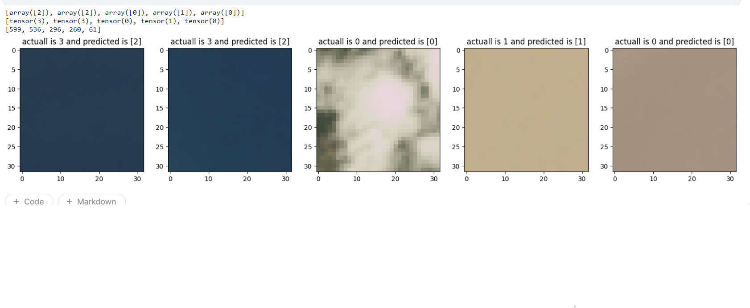
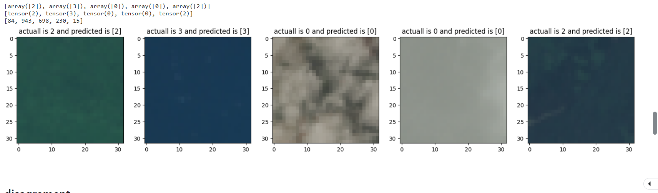
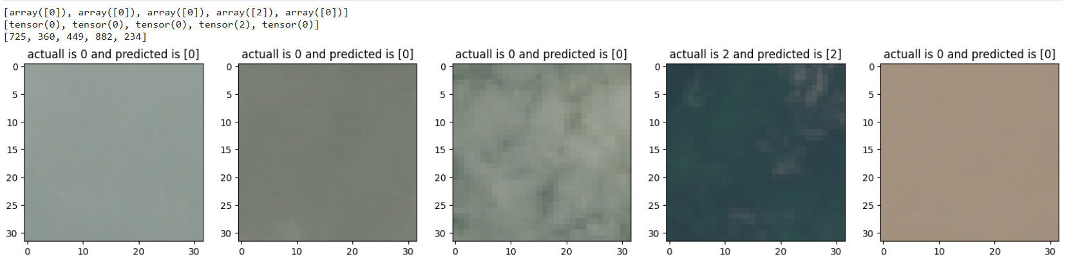
Make predictions using entropy
Make predictions using uncertainty sampling
Make predictions using Disagreement sampling

Slide 9
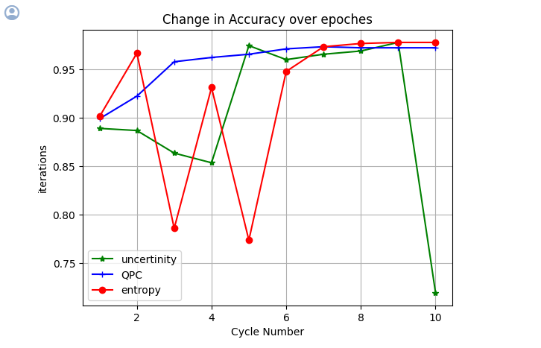
Graph

Slide 10
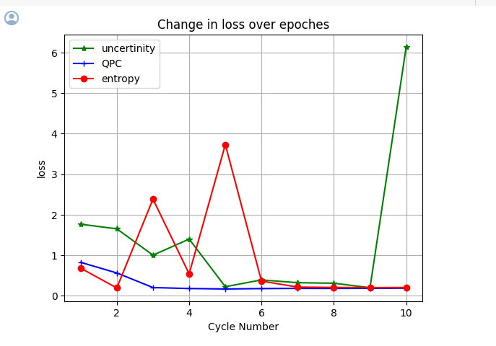
Graph

Slide 11
Cifar10 data
Introduction:
Specifically focusing on the renowned CIFAR-10 dataset. Active learning is a powerful paradigm in machine learning where the model actively selects the most informative data points for labeling, thereby optimizing the learning process.
Objective:
Our objective in this study is twofold: firstly, to introduce the concept of active learning and its application in the realm of image classification; and secondly, to delve into a comparative analysis of different active learning strategies applied to CIFAR-10 image classification. Through this, we aim to provide insights into the efficacy of these strategies and their potential to enhance model performance.

Slide 12
Dataset Overview:
Before we dive into the strategies, let's briefly touch upon the CIFAR-10 dataset. CIFAR-10 comprises 60,000 32x32 color images distributed across 10 classes, with each class representing a distinct object or entity. This dataset serves as a benchmark for image classification tasks due to its diversity and complexity.
Methodology:
1-Data Preparation: We begin by preprocessing the CIFAR-10 dataset, applying standard transformations such as resizing and normalization to prepare it for model training.
2-Model Selection: For our experiments, we opted to employ a ResNet-18 architecture, a popular choice for image classification tasks due to its balance of performance and efficiency.
3-Supervised Learning Baseline: As a baseline, we train the ResNet-18 model using traditional supervised learning techniques, where the entire labeled dataset is utilized for training.

Slide 13
4-Active Learning Strategies:
Random Sampling: We start our exploration by randomly selecting data points from the unlabeled pool for labeling, providing a benchmark for comparison.
Entropy Sampling: This strategy identifies data points where the model exhibits the highest uncertainty in predictions, as measured by entropy.
Uncertainty Sampling: Here, we select data points for labeling based on the model's uncertainty in predictions, typically focusing on instances where prediction confidence is low.
Disagreement Sampling: This strategy leverages the notion of model disagreement, selecting instances where multiple models within an ensemble exhibit divergent predictions.
5-Performance Evaluation: We assess the performance of each strategy based on metrics such as accuracy and loss over multiple epochs, comparing their effectiveness in enhancing model training.

Slide 14
Results and Insights:
Our experiments yielded intriguing insights into the performance of active learning strategies:
Accuracy Trends: We observed that certain strategies, such as entropy and disagreement sampling, consistently outperformed random sampling, showcasing their ability to select more informative data points for model training.
Loss Analysis: Similarly, the loss trends demonstrated that active learning strategies could effectively reduce model uncertainty and enhance convergence rates compared to traditional supervised learning approaches.
Conclusion:
In conclusion, our study underscores the significance of active learning strategies in augmenting model training efficiency and performance. By judiciously selecting data points for labeling, these strategies enable the model to focus on informative instances, thereby reducing the labeling burden and accelerating convergence. However, the effectiveness of each strategy may vary depending on factors such as dataset characteristics and model architecture.

Slide 15
Accuracy Trends
Strategy | Training Accuracy | Test Accuracy
Entropy | 71.78% | 69.41%
Uncertainty Sampling | 72.65% | 71.55%
Disagreement | 73.83% | 70.58%

Slide 16
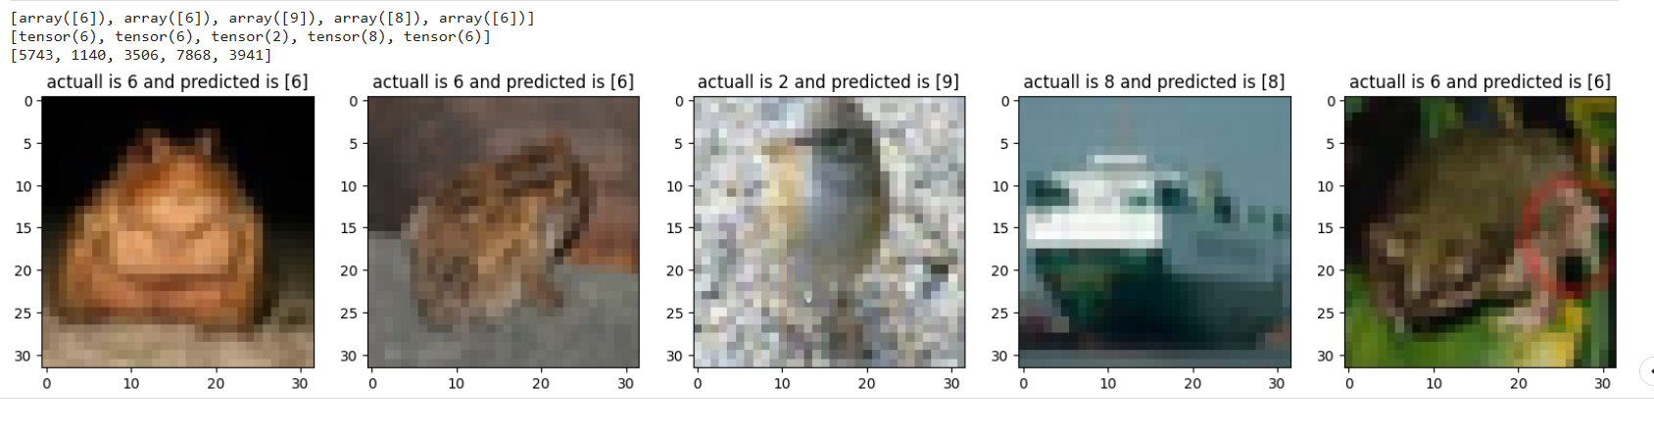
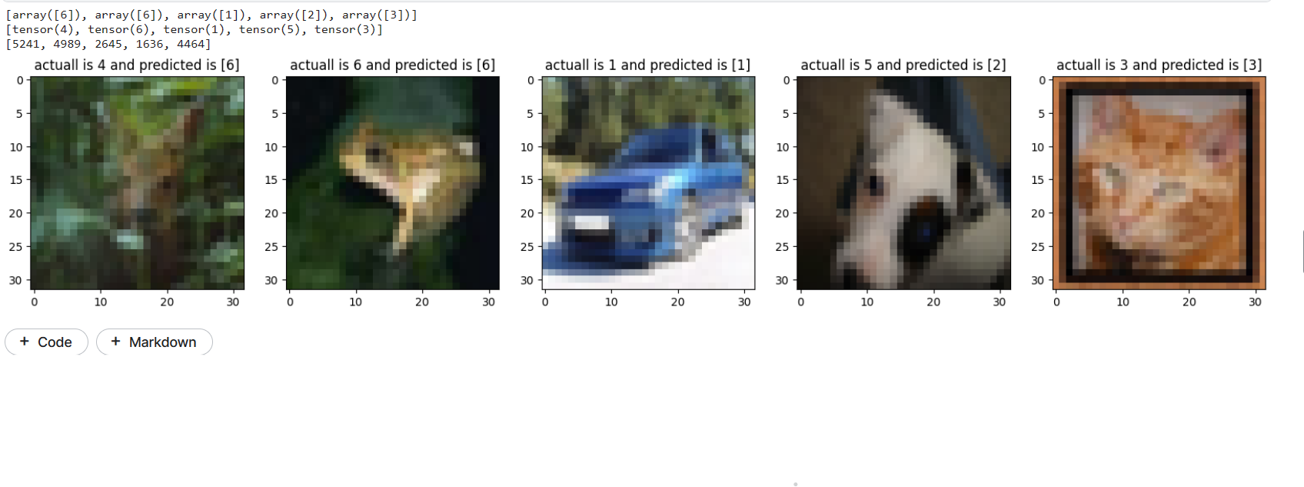
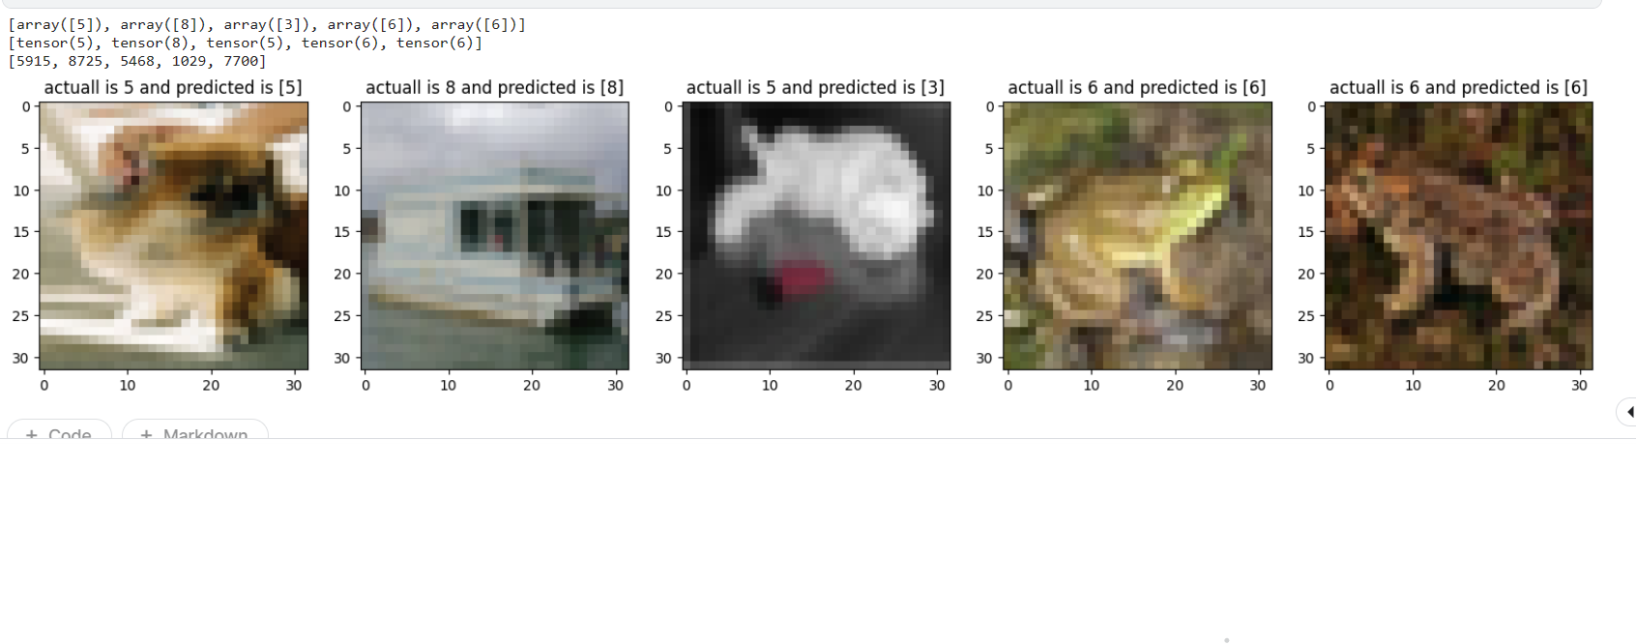
Make predictions using entropy
Make predictions using uncertainty sampling
Make predictions using Disagrement sampling

Slide 17
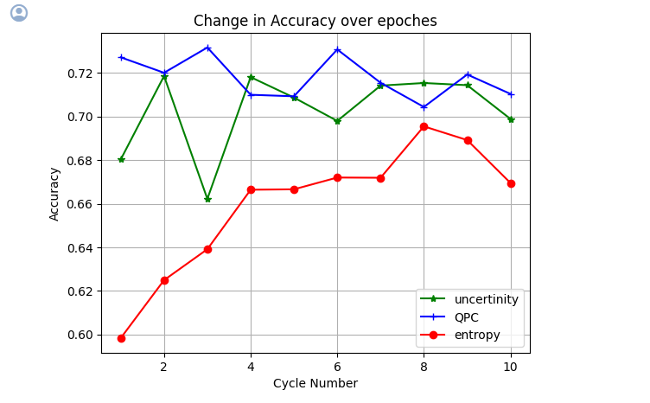

Slide 18
